Slide 1
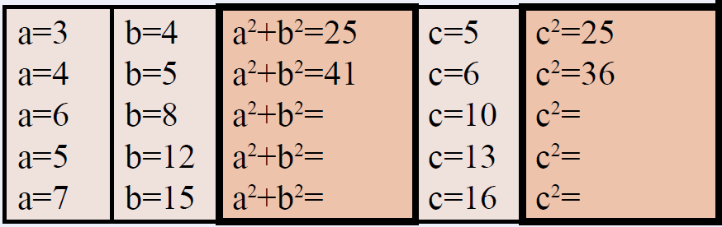
Topic: Pythagoras Theorem EQ: What is the Pythagoras Theorem?
Review questions (on LHS)
Copy and complete this table
Steps to be successful this lesson:
Get materials out (notebook, pen, pencil, ruler, scientific calculator)
Rule up notebook and write Topic and EQ
Start on review questions →
Check your answers with someone sitting next to you
Is your notebook up to date? (Contents page, glossary, summary, review notes etc.)

Slide 2
Pythagoras Introduction
Year 9 Mathematics

Slide 3
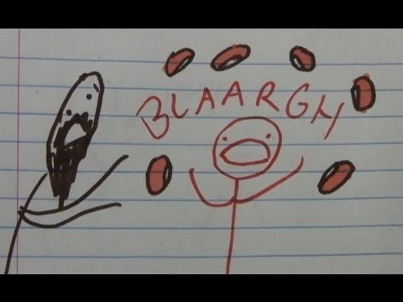
Who Was Pythagoras?
https://www.youtube.com/watch?v=X1E7I7_r3Cw

Slide 4
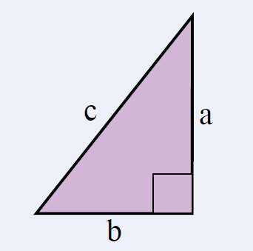

24
7
30
Topic: Pythagoras Theorem
Date: /06/2018
EQ – What is the Pythagoras Theorem?
For any right-angled triangle:
The square on the hypotenuse is equal to the sum of the squares on the other two sides
The hypotenuse is the longest side of a right-angled triangle.
It is opposite the right angle.

Slide 5
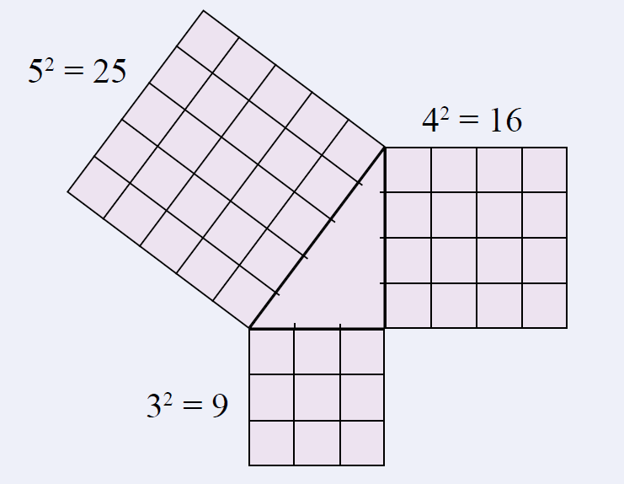
24
7
30
Topic: Pythagoras Theorem
Date: /06/2018
EQ – What is the Pythagoras Theorem?
For any right-angled triangle:
The square on the hypotenuse is equal to the sum of the squares on the other two sides
Example:

Slide 6
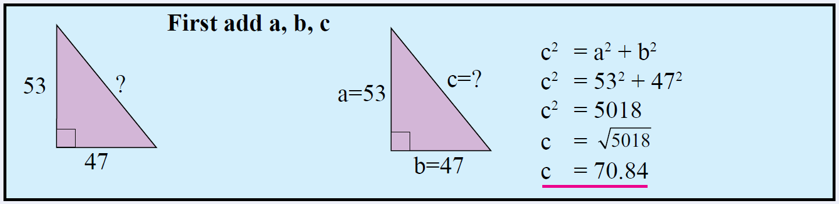

24
7
30
Topic: Pythagoras Theorem
Date: /06/2018
EQ – What is the Pythagoras Theorem?
Worked Example:
Find the length of the hypotenuse in this right-angled triangle.
How do we find the length of the hypotenuse?

Slide 7

We Do
What side is the hypotenuse?
Determine the length of the hypotenuse.
Answers
The hypotenuse is side f.
d = 12cm
$$f^{2}=d^{2}+e^{2}$$
$$f^{2}={12}^{2}+5^{2}$$
$$f^{2}=144+25$$
$$f^{2}=169$$
$$f=\sqrt{169}$$
$f=13$ cm
e = 5cm
f

Slide 8


Slide 9
Task
Excel Worksheets
Naming the Hypotenuse
Find the Length of the Hypotenuse
Dwyer Year 9 Text
Exercise 7.3
Questions 1- 6
Notes:
Dark hair, not dark hair
Short hair, long hair
Alternatives: boy / girl, shorts/pants

